Slide 1

Evaluation and Prediction of Cell Phone Sales Based on Various Techniques
Lingwei Cao, Cheng Qian, Zhaoyang Tian
Tsinghua High School
Advisor: Hao Wu, Dianjun Wang

Slide 2
Agenda
Research Background
Assumptions
Data Extraction and Process
Modeling
Optimization
Application
Sensitivity Analysis
Conclusion

Slide 3
01
Research Background
Research Purposes and significance

Slide 4
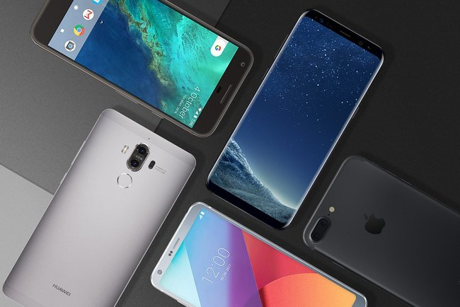
Research Background
Technology advancement
Online shopping
Fast-pace life
Manufacturers and sellers
Key to promoting sales
Cellphones

Slide 5
Research Background
1
2
Purpose
1
Grey Relational Analysis
——Fatao Wang 2013
3
Previous Researches
C2C Model
——Youzhi Xue 2012
2
3
BP Neural Network Fitting
——Yanli Ma 2014
Defects

Slide 6
Raw Data
Ali Express
Data Extraction
Extract relevant variables
Data Process
Modeling
Reduce variables
qualitative conclusions
single variable
Research Background
Conclusion
Application
statistic results
strength and weakness
precision assessment
predict sales volume
quantitative conclusions
multi-variables
Sensitivity Analysis
Optimization

Slide 7
02
Assumptions
To simplify real-world implications without the loss of the core

Slide 8


Basic Assumptions
$$convert rate=\frac{number of people who buy the cellphones}{number of people who click the pictures}$$
$$click rate=\frac{number of people who click the pictures}{number of people who browse the website}$$
$$click rate×convert rate=sale rate$$
Sales volume

Slide 9
03
Data Extraction and Process
Find key independent variables

Slide 10

Information Entropy
Information entropy(E(x) as the following) is used to measure the information we can get from a particular variable. Apply the information entropy to the calculation of information gain will further help us to sift out the most important independent variables.
The calculation of information entropy is based on the variables’ relationship with Category Convert and Click Rate, both of which represent the cell phones’ sales volume. The calculation of information gain of ROM is given here as an example.
ROM(GB) | Group number in Category Click Rate | 1 | 2 | 3 | 4 | 5 | Information entropy
 | 2 | 0 | 3 | 2 | 1 | 0 | 1.459148
 | 4 | 5 | 6 | 13 | 7 | 0 | 1.89366
 | 8 | 64 | 38 | 63 | 54 | 8 | 2.122787
 | 16 | 110 | 89 | 132 | 143 | 36 | 2.205866
 | 32 | 64 | 44 | 82 | 63 | 29 | 2.242444
 | 64 | 83 | 38 | 62 | 49 | 16 | 2.160525
 | 128 | 3 | 4 | 5 | 7 | 0 | 1.931295
 | 256 | 0 | 0 | 1 | 0 | 0 | 0

Slide 11
Information Entropy
Compare the information gain across all the variables, and we can thus rank the most important ones.
 | Category Click Rate | Category Convert Rate
Global information entropy | 2.200779 | 2.081891
 | Sum of the products | Information Gain
ROM | 2.174619842 | 0.026159369
Ranking of variables depends on Category Click Rate | Information Gain
Comment Count | 0.732792417
Good Comment Count | 0.680453664
Search Count | 0.392386753
Score | 0.173242295
Brand | 0.124112475
Is Gallery Featured | 0.060358001
Battery Capacity(mAh) | 0.050232189
RAM(G) | 0.031072544
Ranking of variables depends on Category Convert Rate | Information Gain
Comment Count | 0.950131659
Good Comment Count | 0.910616696
Search Count | 0.631528548
Score | 0.288394004
Brand | 0.261397755
Is Gallery Featured | 0.220147548
Battery Capacity(mAh) | 0.102065066
Highest camera resolution | 0.067310002

Slide 12
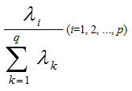
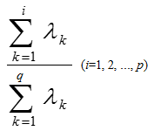



Principal Component Analysis
Principal Component Analysis (PCA) processes the data again, reduces parameters and retains the original data information as much as possible.
Using formulas above to standardize data, calculating eigenvectors and total contribution rates of PCA. The first 14 principal components (whose contribution rate over 80%) were selected.
$$z_{1}=a_{11}x_{1}+a_{21}x_{2}+a_{31}x_{3}+a_{41}x_{4}+a_{51}x_{5}+…+a_{26 1}x_{26}$$
$$z_{2}=a_{12}x_{1}+a_{22}x_{2}+a_{32}x_{3}+a_{42}x_{4}+a_{52}x_{5}+…+a_{26 2}x_{26}$$
$$…$$
$$z_{14}=a_{1 14}x_{1}+a_{2 14}x_{2}+a_{3 14}x_{3}+a_{4 14}x_{4}+a_{5 14}x_{5}+…+a_{26 14}x_{26}$$

Slide 13
04
Modeling
Qualitative conclusion and in-depth analysis

Slide 14

Weight Determination Technique
Target Layer (RAM)
P₁
P₂
P₃
Scheme Layer(Click Rate)
C₁
C₂
C₃
C₄
C₅
$$Aw=λw$$
Among phones with middle display resolution, both phones with higher click rate and lower click rate takes a large proportion.
Losgistic Regression
Click Rate | Convert Rate
0.115124 | 0.162528
KNN Algorithm

Slide 15
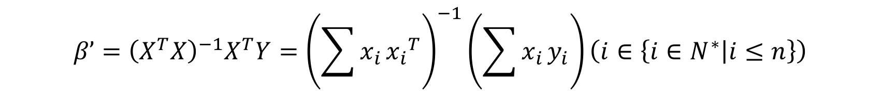
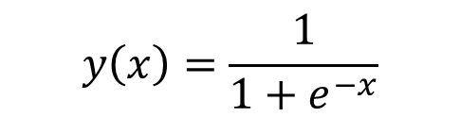

Losgistic Regression
$$y_{n}=β_{0}+β_{1}x_{1}+β_{2}x_{2}+β_{3}x_{3}+β_{4}x_{4}+β_{5}x_{5}+β_{6}x_{6}\left(n∈\left\{1,2\right\}\right)$$
$$β’={\left(X^{T}X\right)}^{−1}X^{T}Y={\left(\sum{x_{i}}{x_{i}}^{T}\right)}^{−1}\left(\sum{x_{i}}y_{i}\right)\left(i∈\left\{i∈N^{∗} | i≤n\right\}\right)$$
$$P\left\{{\hat{θ}}_{1}<θ<{\hat{θ}}_{2}\right\}=1−α$$
$$P\left\{{\hat{β}}_{n 1}<β<{\hat{β}}_{n 2}\right\}=1−α \left(n∈\left\{n∈N^{∗} | n≤2\right\}\right)$$
$$y\left(x\right)=\frac{1}{1+e^{−x}}$$

Slide 16
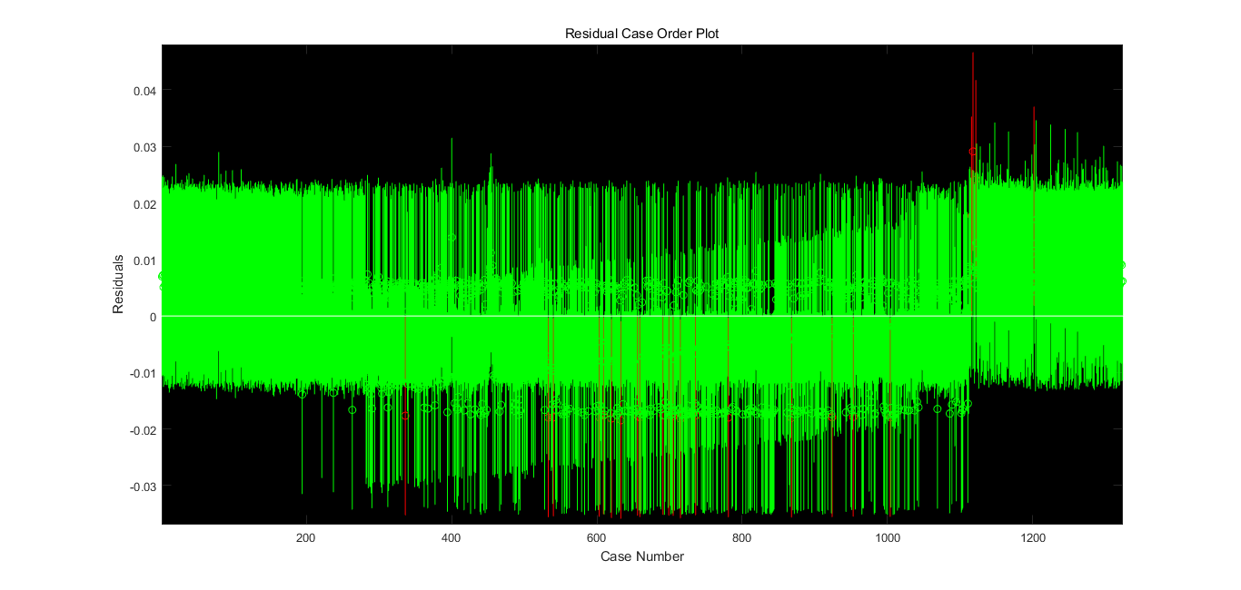
Losgistic Regression
Not much Outliers.

Slide 17
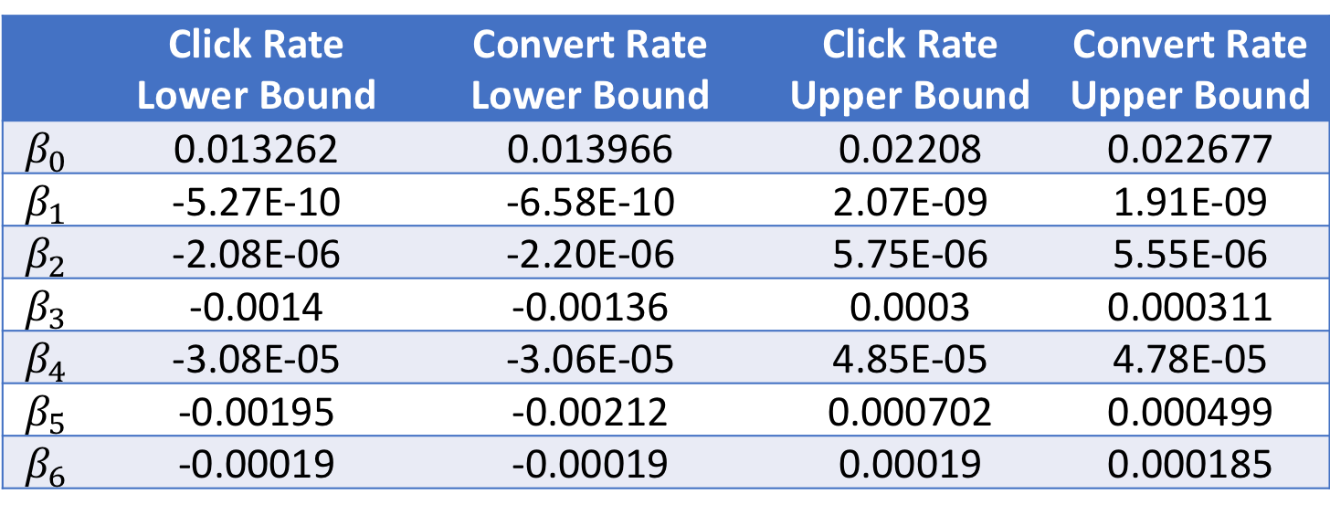
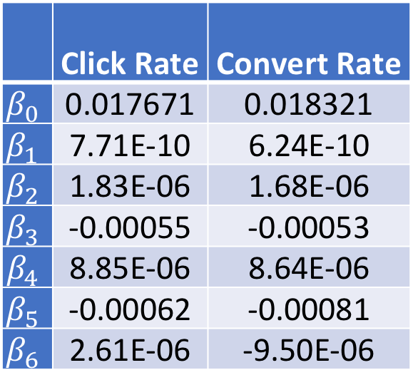
Losgistic Regression
 | Click Rate | Convert Rate
$$β_{0}$$ | 0.017671 | 0.018321
$$β_{1}$$ | 7.71E-10 | 6.24E-10
$$β_{2}$$ | 1.83E-06 | 1.68E-06
$$β_{3}$$ | -0.00055 | -0.00053
$$β_{4}$$ | 8.85E-06 | 8.64E-06
$$β_{5}$$ | -0.00062 | -0.00081
$$β_{6}$$ | 2.61E-06 | -9.50E-06
The low correlation coefficients in Logistic Regression is insufficient to reveal the features of each variable precisely.
Click Rate | Convert Rate
0.115124 | 0.162528
 | Click Rate Lower Bound | Convert Rate Lower Bound | Click Rate Upper Bound | Convert Rate Upper Bound
$$β_{0}$$ | 0.013262 | 0.013966 | 0.02208 | 0.022677
$$β_{1}$$ | -5.27E-10 | -6.58E-10 | 2.07E-09 | 1.91E-09
$$β_{2}$$ | -2.08E-06 | -2.20E-06 | 5.75E-06 | 5.55E-06
$$β_{3}$$ | -0.0014 | -0.00136 | 0.0003 | 0.000311
$$β_{4}$$ | -3.08E-05 | -3.06E-05 | 4.85E-05 | 4.78E-05
$$β_{5}$$ | -0.00195 | -0.00212 | 0.000702 | 0.000499
$$β_{6}$$ | -0.00019 | -0.00019 | 0.00019 | 0.000185

Slide 18
05
Optimization
Optimize the algorithms and quantitative conclusions

Slide 19
Principal Component Analysis
$${y_{n}}^{∗}=β_{1}′z_{1}+β_{2}′z_{2}+β_{3}′z_{3}+…+β_{14}′z_{14}\left(n∈\left\{n∈N^{∗} | n≤2\right\}\right)$$
$$y_{n}=β_{0}+β_{1}x_{1}+β_{2}x_{2}+β_{3}x_{3}+…+β_{26}x_{26}\left(n∈\left\{1,2\right\}\right)$$
Click Rate | Convert Rate
0.805032 | 0.826614

Slide 20
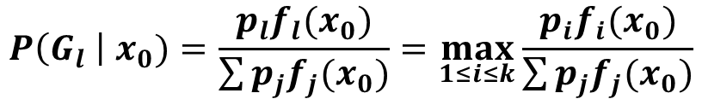
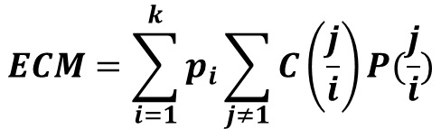
Bayes Distinction
 | High sales | Low sales
High display resolution | 7 | 1
Low display resolution | 3 | 9
$$P\left(G_{l} \right| x_{0})=\frac{p_{l}f_{l}(x_{0})}{\sum{p_{j}f_{j}(x_{0})}}=\max_{1≤i≤k}{\frac{p_{i}f_{i}(x_{0})}{\sum{p_{j}f_{j}(x_{0})}}}$$
$$ECM=\sum_{i=1}^{k}{p_{i}\sum_{j≠1}{C\left(\frac{j}{i}\right)P(\frac{j}{i})}}$$

Slide 21
Bayes Distinction
RAM to Click rate (the smaller the category is, the lower the click rate is)
 | Category 1 | Category 2 | Category 3 | Category 4
0.125 | 2 | 0 | 0 | 0
0.5 | 7 | 0 | 0 | 1
1 | 49 | 0 | 1 | 7
1.5 | 1 | 0 | 0 | 0
2 | 91 | 0 | 15 | 25
3 | 41 | 1 | 64 | 19
4 | 1 | 13 | 68 | 2
6 | 0 | 11 | 22 | 0
8 | 0 | 0 | 1 | 0
Phones with higher display resolution are apt to reveal more satisfactory sales condition. Phones with middle RAM may experience low sales or high sales.

Slide 22
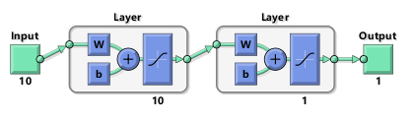
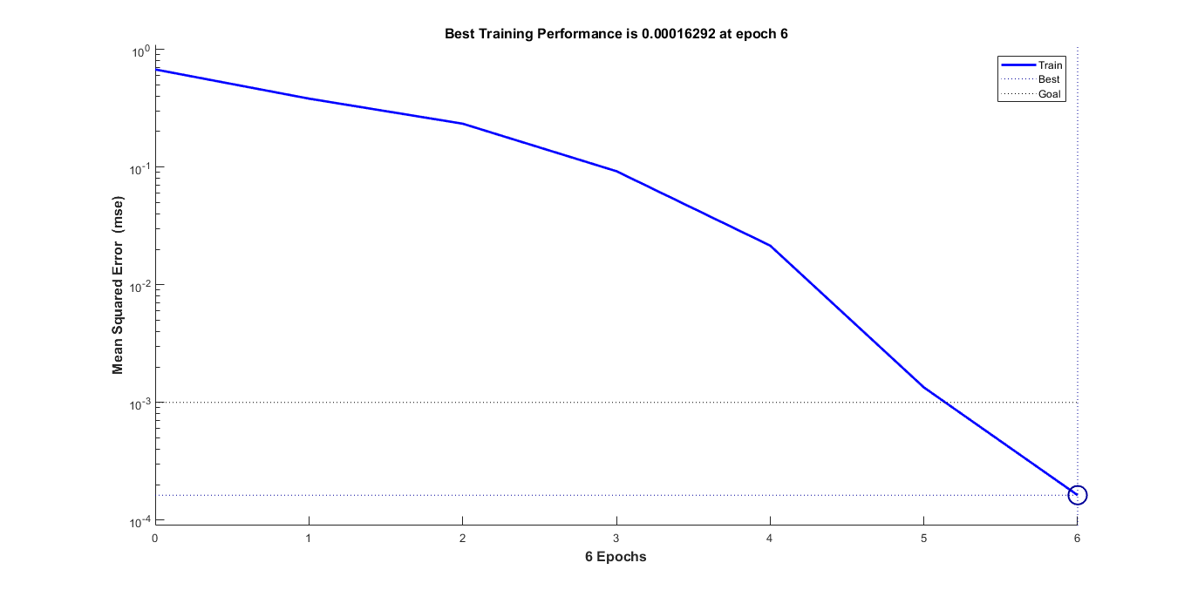
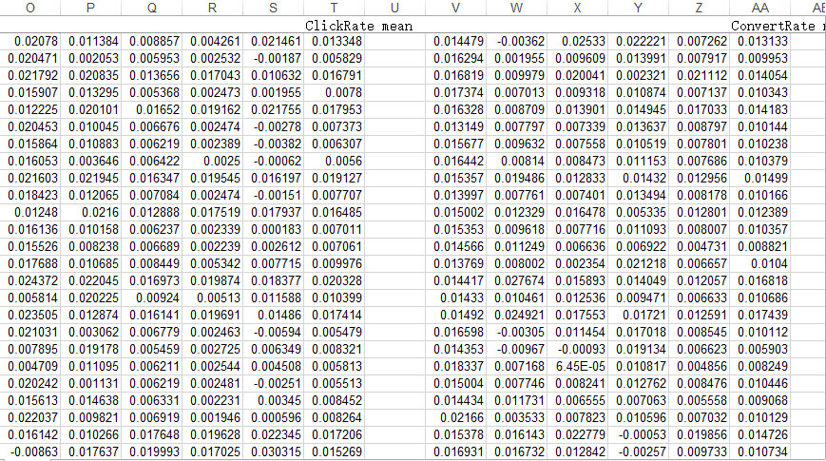
BP Neural Network
Model with 10 layers do not consume too much time, while it has a better performance. The error is decreasing rapidly. The error of some data in the table lower than 1%.

Slide 23
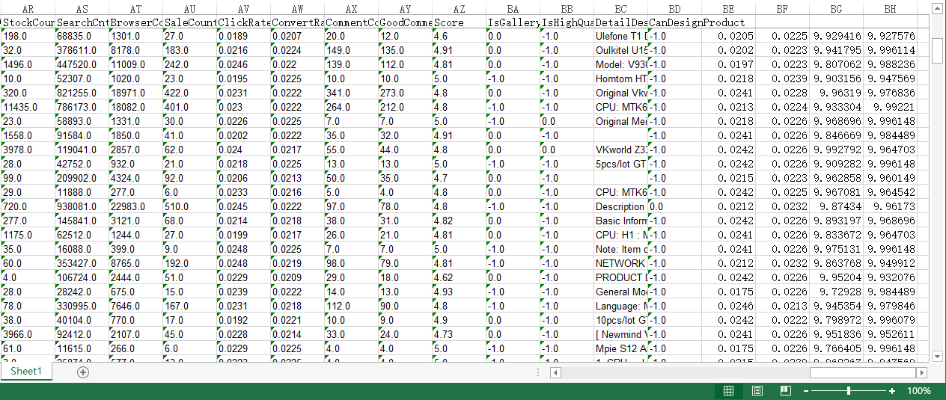
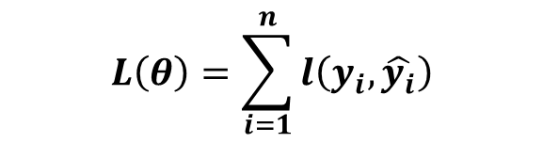
Age | Monthly shopping Amount | Usually asking or answering on Quora
14 | Less than 1000 yuan | Asking
16 | Less than 1000 yuan | Answering
24 | More than 1000 yuan | Asking
26 | More than 1000 yuan | Answering
XGBoosting
Algorithm
$$L\left(θ\right)=\sum_{i=1}^{n}{l\left(y_{i},\hat{y_{i}}\right)}$$
Combining several weak classifier into a strong classifier through minimizing loss function and error.

Slide 24
06
Application
To predict sales volume with given characteristics

Slide 25
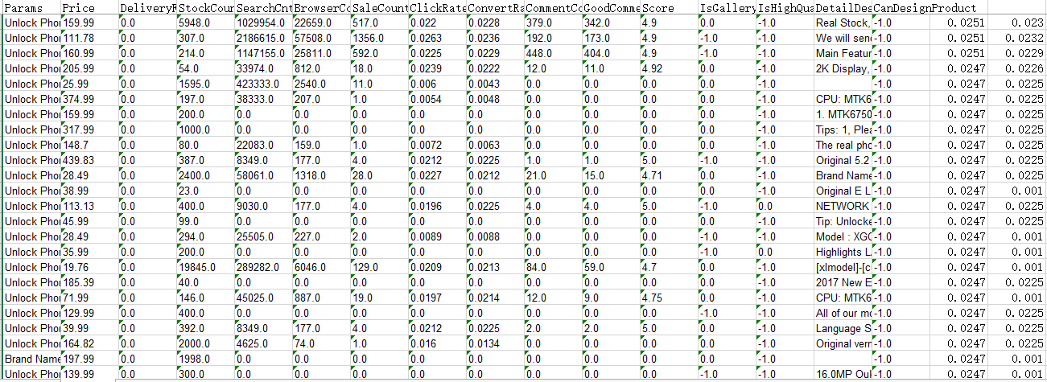
Application
test sets
four modeling process
predict sales volume

Slide 26
07
Sensitivity Analysis
To assess the accuracy and stability of models

Slide 27
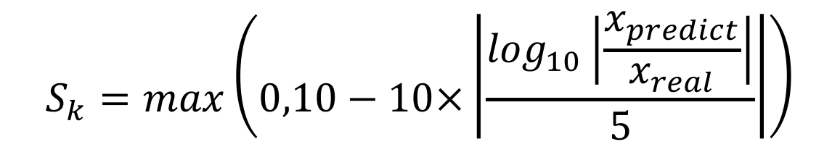
Sensitivity Analysis
Scoring formula to the application:
$$S_{k}=max\left(0,10−10×\left|\frac{\log_{10}\left|\frac{x_{predict}}{x_{real}}\right|}{5}\right|\right)$$
Click rate：9.81
Convert rate：9.74

Slide 28
Sensitivity Analysis
detect the stability of our model, especially when the given data are not accurate
Sensitivity analysis
continuous variables
1% increase or decrease
Principal Component Regression: 1%
discrete variables
change the value of one property to adjacent category each time
eg. 2G to 4G
Bayes Distinction: 0
BP neural network: 1%
largest unchanged
The output changes 1%

Slide 29
08
Conclusion
Strength and weakness

Slide 30
Ranking of independent variables
Ranking of independent variables | Independent variables
1 | Comment Count
2 | Good Comment Count
3 | Search Count
4 | Score
5 | Brand
6 | Is Gallery Featured
7 | Battery Capacity(mAh)
8 | Highest camera resolution

Slide 31
Conclusion of modeling and optimization
Phones of middle display resolution, low or high recording resolution, high camera resolution and middle price are more popular with customers. High RAM, ROM and CPU harvests high Category Click Rate.
Phone of middle battery capacity, gold or white color and high camera resolution is the best model predicted. The graph on the left shows the direct conclusion gained by weigh-determining process.

Slide 32
Discovery in analysis
Priority
Insensitive variables
RAM,ROM,CPU can be the first choice when improving the phone’s quality
Public are insensitive to the change in display resolution and camera resolution, so manufacturers should give more thought to lowering the price when these two factors are taken into account.

Slide 33
Strengthen of our methods
Qualitative analysis
Weigh-determining method can display straightforward analysis towards important independent variables, aiding as an auxiliary analysis
Variables ranking
PCA and BP neuron network fitting give the quantitative methods for the analysis of independent variables, which help to explore the needs of the public as well as give the ranking of most important variables.
Quantitative optimization
The optimized models give quantitative analysis towards specific traits of cell phones, the results of which could guide the optimization of cell phone products among manufacturers.
The application and optimized model could successfully predict the sales volume of cell phones based on the testing set, which gives our model pragmatic value in the field of economy.
Application value

Slide 34
Thank You
Lingwei Cao, Cheng Qian, Zhaoyang Tian
Tsinghua High School
Advisor: Hao Wu, Dianjun Wang

